Slide 1
EUROPEAN DIGITAL PORTFOLIO FOR UNIVERSITY STUDENTS
European Digital Portfolio for University Students
“The e-Portfolio for all University Students in Europe”
This project is supported by the EU. Any communication or publication related to the Project made by the beneficiaries jointly or individually in any form and using any means, shall indicate that it reflects only the author's view and that the NA and the Commission are not responsible for any use that may be made of the information it contains.

Slide 2
C4. Highlighting professional and development goals
“Who fails to plan is planning to fail” Winston Churchill
To go further on both professional and personal levels, applicants can create and implement a list or plan of goals they want to reach in order to enhance their performance and effectiveness.
Some reasons to create a Professional Development Plan could be:
It is a tangible tool to be used for future reference.
It will give you the confidence needed to succeed.
It helps you to identify: current and future needs, specific “to do” items and resources needed.
It creates a structured plan and timeline.
Workplace is constantly changing – Applicants have to grow and develop in order to keep up and move forward.
Less job security – Applicants need to be active, taking the responsibility of their growth.
Traditional “corporate ladders” are going away – There is no a “defined” career plan. Applicants need to find opportunities to grow.
This project is supported by the EU. Any communication or publication related to the Project made by the beneficiaries jointly or individually in any form and using any means, shall indicate that it reflects only the author's view and that the NA and the Commission are not responsible for any use that may be made of the information it contains.

Slide 3
C4. Highlighting professional and development goals
That kind of process demonstrates candidates’ dynamic, their way of being proactive as in life as on the workplace. It shows a high understanding of their strengths and weaknesses and their will to develop a skill set to remain effective and relevant on the labour market: improve for the better and be outstanding. In short it proves they want to excel themselves. Professionally, it is thus greatly considered when applicants share their on-going or future professional and development goals and how they want to reach them as it gives more depth to their application or Digital Portfolio for instance.
It is suggested that candidates create their own professional and development plan with their on-going or future goals, the steps to follow and achieve those goals and the reason why those goals are set because it demonstrates a constructive, rational and valuable way of thinking and working.
This project is supported by the EU. Any communication or publication related to the Project made by the beneficiaries jointly or individually in any form and using any means, shall indicate that it reflects only the author's view and that the NA and the Commission are not responsible for any use that may be made of the information it contains.

Slide 4
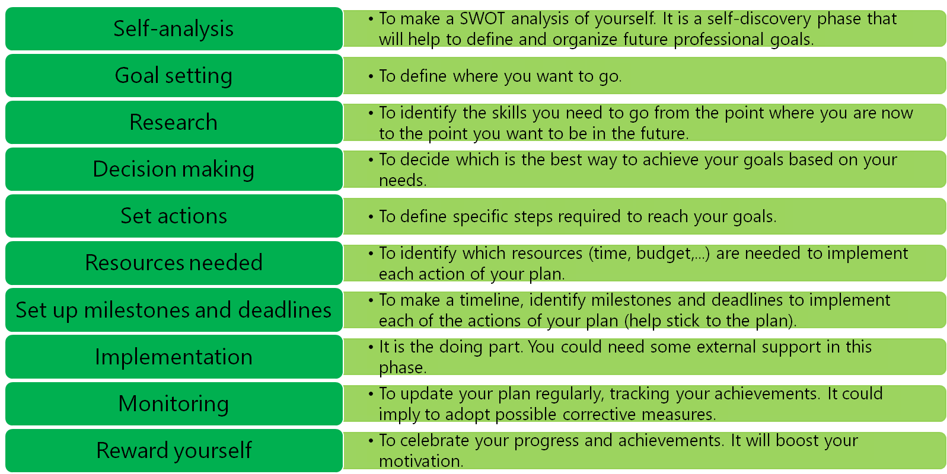
C4. Highlighting professional and development goals
Steps to create your own professional development plan:
This project is supported by the EU. Any communication or publication related to the Project made by the beneficiaries jointly or individually in any form and using any means, shall indicate that it reflects only the author's view and that the NA and the Commission are not responsible for any use that may be made of the information it contains.

